Slide 1
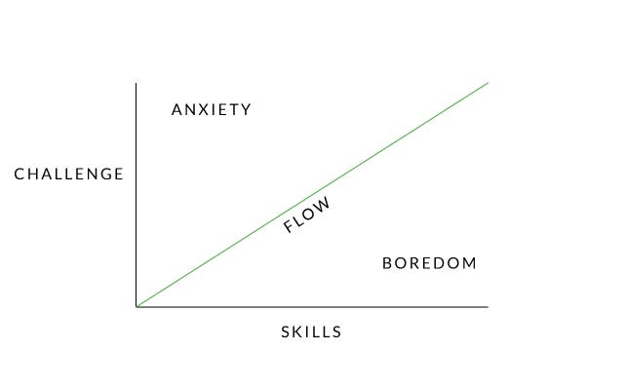
Find Your Flow
When people find their fit, they experience a state of happiness and creativity called flow.
Be honest about your strengths and weaknesses
Don’t let yourself get too comfortable
Learn to take risks

Slide 2
Entrepreneurial styles
1.Visionary Entrepreneur:
Example: Elon Musk, the founder of SpaceX and Tesla, is known for his visionary approach to space exploration and sustainable energy.
2. Serial Entrepreneur:
Example: Richard Branson, the founder of the Virgin Group, has started numerous businesses in various industries, including music, airlines, telecommunications
3. Lifestyle Entrepreneur:
Example: Tim Ferriss, known for his book "The 4-Hour Workweek," promotes a lifestyle that combines entrepreneurship with personal freedom and travel.
4. Social Entrepreneur:
Example: Blake Mycoskie, the founder of TOMS Shoes, built a business model around the concept of "One for One," where for every pair of shoes sold, a pair is donated to a child in need.

Slide 3
5.Opportunistic Entrepreneur:
Example: Nick D'Aloisio created Summly, a news summarization app, when he was just 15 years old after recognizing the need for concise news summaries on mobile devices. Yahoo later acquired his company.
6.Innovator/Inventor:
Example: Steve Jobs, co-founder of Apple Inc., was known for his innovative products such as the iPhone, iPad, and Macintosh computer.
7.Franchise Entrepreneur:
Example: Ray Kroc, who turned McDonald's into a global fast-food franchise, is a classic example of a franchise entrepreneur.
8.Solo Entrepreneur/Solopreneur:
Example: Pat Flynn, the creator of Smart Passive Income, runs a successful online business independently, focusing on passive income strategies.

Slide 4
9.Growth-Oriented Entrepreneur:
Example: Jeff Bezos, the founder of Amazon, is a growth-oriented entrepreneur who aggressively expanded his company from an online bookstore into a global e-commerce and technology giant.
10.Niche Specialist:
Example: Brian Dean, founder of Backlinko, specializes in search engine optimization (SEO) and provides in-depth content and resources to a niche audience within the digital marketing space.
11.Tech Entrepreneur:
Example: Mark Zuckerberg, co-founder of Facebook (now Meta Platforms, Inc.), started a social media platform that has transformed the way people connect and share information online.
12.Collaborative Entrepreneur:
Example: Larry Page and Sergey Brin co-founded Google, which has formed numerous partnerships and collaborations with other technology companies and organizations over the years.

